Slide 1
corona data tabaleau

Slide 2
Global number of confirmed covid -19 cases
Global number of death from covid 9
Global no of recovered cases from covid 19
Regional summary of covid -19
Countrry summary of covid -19

Slide 3
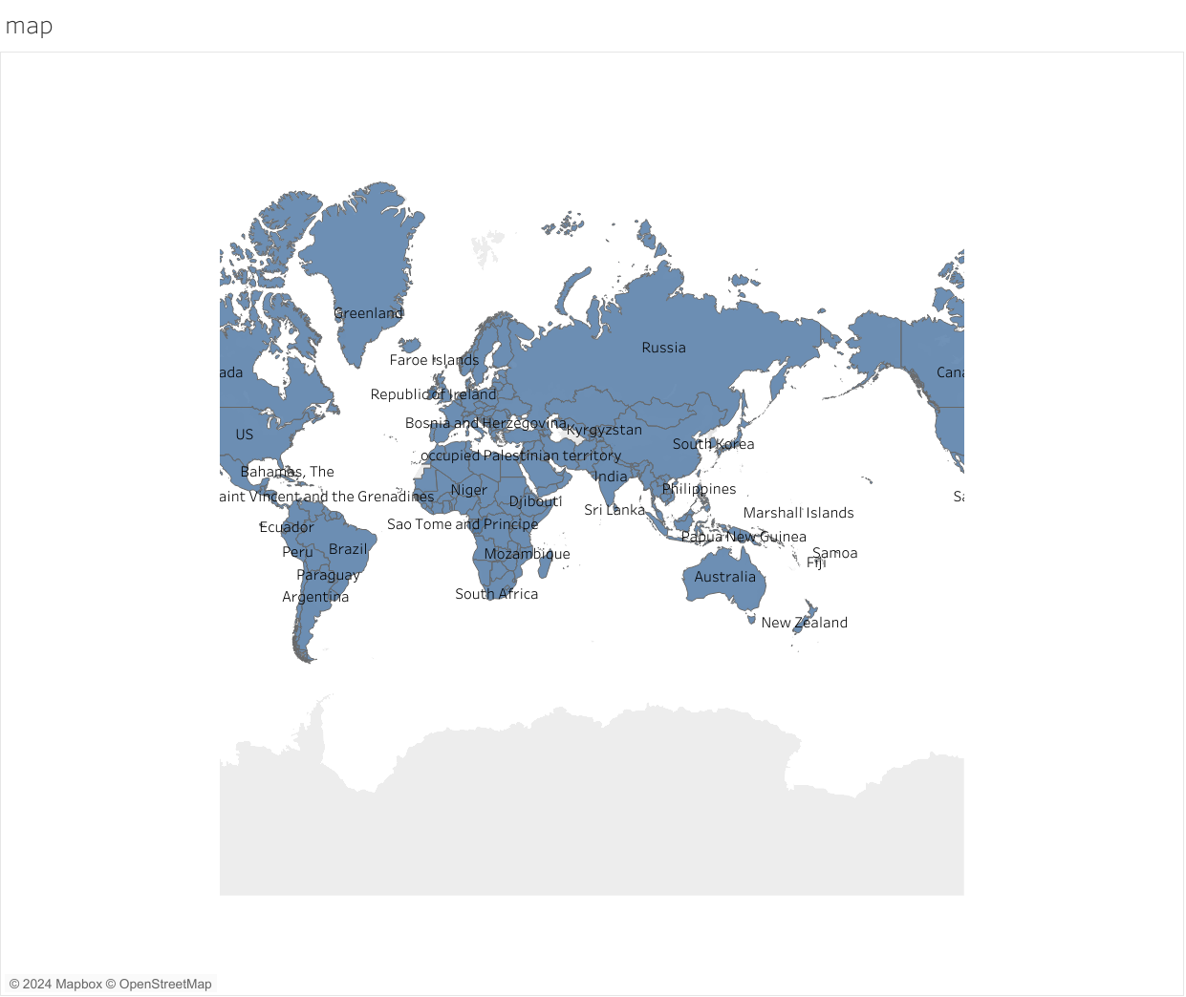

Slide 4
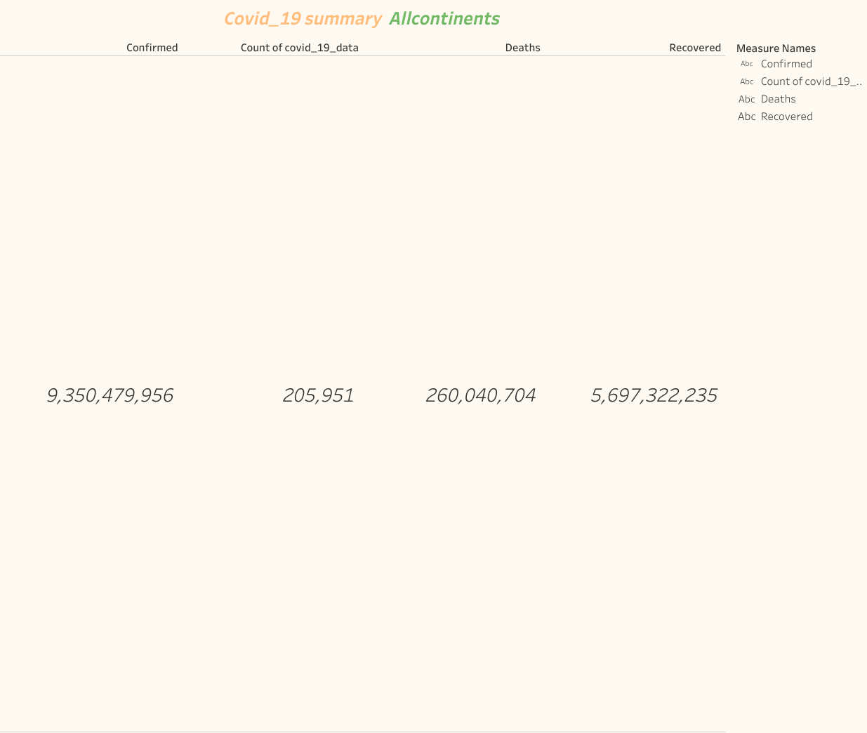

Slide 5
